Slide 1
Graph Traversal
EECS 233

Slide 2
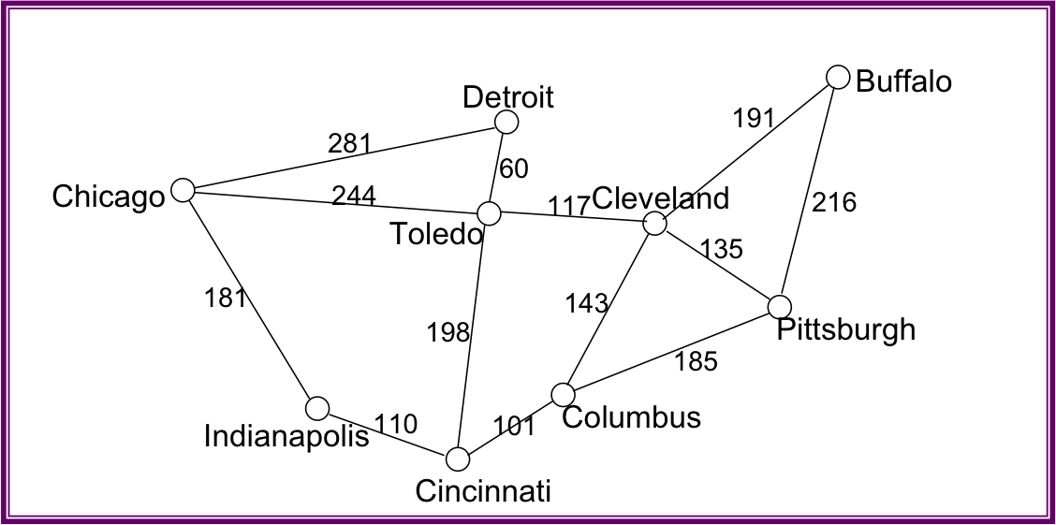
Graph Traversals
Traversing a graph involves starting at some vertex and visiting all of the vertices that can be reached from that vertex.
  visiting a vertex = processing its data in some way
  if the graph is connected, all of the vertices will be visited
Example:
  A Web crawler (vertices = pages, edges = links)
We will consider two types of traversals:
  depth-first:
    Visit the starting vertex
    Proceed as far as possible along a given path (via a neighbor) before “backtracking” and going along the next path
  breadth-first:
    visit the starting vertex
    visit all of its neighbors
    visit all unvisited vertices 2 edges away
    visit all unvisited vertices 3 edges away, etc.

Slide 3
1
191
2
216
0
Buffalo
null
1
0
191
2
135
3
143
5
117
Cleveland
null
0
191
1
135
3
185
2
Pittsburgh
null
3
Columbus
1
143
2
135
4
101
null
4
Cincinnati
3
101
5
198
8
110
null
5
Toledo
1
117
4
198
6
60
7
244
null
6
Detroit
5
60
7
281
null
7
Chicago
5
244
6
281
8
181
null
8
Indianapolis
4
110
7
181
null

Slide 4
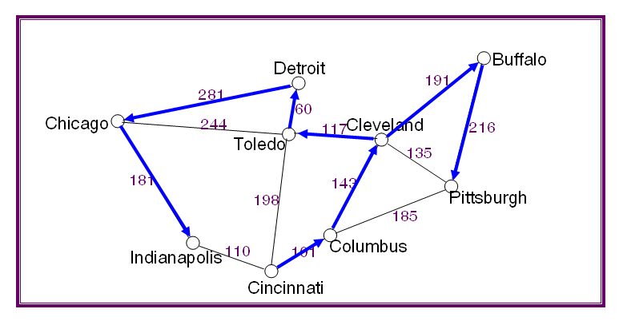
Depth-first Traversal
Visit a vertex, then make recursive calls on all of its yet-to-be-visited neighbors:
  depthFirstTrav(v)_x0010_
  myDepthFirstTrav(v, NULL)
public class Graph {
  class Vertex {
    private String id;
    private linkedList <Edge> edges; // adjacency list
    private boolean encountered;
    private boolean done;
    private Vertex parent;
    private double cost;
    …
  }
  class Edge {
    private int endNode;
    private double cost;
    …
  }
  private Vertex[] vertices;
  private int numVertices;
  private int maxNum;
  …
}
myDepthFirstTrav(node, parent)
visit node and mark it as visited
node.parent = parent
for each vertex w in node’s neighbors
if (w has not been visited)
myDepthFirstTrav(w, node)

Slide 5
Depth-first Traversal
Visit a vertex, then make recursive calls on all of its yet-to-be-visited neighbors:
  myDepthFirstTrav(v, parent)
    visit v and mark it as visited
    v.parent = parent
    for each vertex w in v’s neighbors
      if (w has not been visited)
        myDepthFirstTrav(w, v)
Implementation:
  public void myDepthFirstTrav(int i, int parent) {
    System.output.println(vertices[i].id);
    vertices[i].encountered = true;
    vertices[i].parent = parent;
    Iterator<Edge> edgeItr = edges.iterator();
    while (edgeItr.hasNext()) {
    Edge curEdge = edgeItr.next()
      j = curEdge.endNode;
      if (vertices[j].encountered == false)
        myDepthFirstTrav(j, i);
    }
  }
public class Graph {
  class Vertex {
    private String id;
    private linkedList <Edge> edges; // adjacency list
    private boolean encountered;
    private boolean done;
    private Vertex parent;
    private double cost;
    …
  }
  class Edge {
    private int endNode;
    private double cost;
    …
  }
  private Vertex[] vertices;
  private int numVertices;
  private int maxNum;
  …
}

Slide 6
Example: From Buffalo
Detroit
Buffalo
191
281
60
Chicago
244
117
Cleveland
216
Toledo
135
181
143
198
Pittsburgh
185
Indianapolis
110
101
Columbus
Cincinnati
myDepthFirstTrav(“Buffalo”, null)
visit Buffalo; Buffalo.parent = NULL
  w = “Cleveland”
  myDepthFirstTrav(“Cleveland”, “Buffalo”)
  visit Cleveland; Cleveland.parent = Buffalo
    w = “Pittsburgh”
    myDepthFirstTrav(“Pittsburgh”, “Cleveland”)
    visit Pittsburg; Pittsburg.parent = Cleveland
    w = “Buffalo”; Buffalo has been visited
      w = “Columbus”
      myDepthFirstTrave(“Columbus”, “Pittsburgh”)
      visit Columbus; Columbus.parent = Pittsburg;
        w = “Cincinnati”
        myDepthFirstTrav(“Cincinnati”, “Columbus”)
        …
  myDeapthFirstTrav(v, parent)
    visit v and mark it as visited
    v.parent = parent
    for each vertex w in v’s neighbors
      if (w has not been visited)
        myDeapthFirstTrav(w, v)

Slide 7
Example: From Cincinnati
Detroit
Buffalo
191
281
60
Chicago
244
117
Cleveland
216
Toledo
135
181
143
198
Pittsburgh
185
Indianapolis
110
101
Columbus
Cincinnati
Order: Cincinnati, Columbus, Cleveland, Buffalo, Pittsburg, Toledo, Detroit, Chicago, Indianapolis

Slide 8
Depth-First Spanning Trees
Cincinnati
Columbus
Cleveland
Buffalo
Toledo
Pittsburgh
Detroit
Chicago
Indianapolis

Slide 9
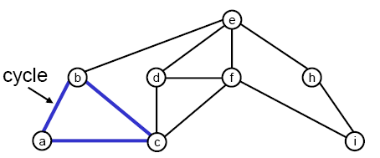
An Application: Checking for Cycles
  To discover a cycle:
  perform a depth-first traversal
    when considering the non-parent neighbors of a current vertex, if we discover one that is already marked as visited, there is a cycle
  If we discover no cycles during the course of the traversal, the graph is acyclic.

Slide 10
Breadth-First Traversal
Detroit
Buffalo
191
281
60
Chicago
244
117
Cleveland
216
Toledo
135
181
143
198
Pittsburgh
185
Indianapolis
110
101
Columbus
Cincinnati
Order: Cincinnati, Columbus, Toledo, Indianapolis, Pittsburgh, Cleveland, Detroit, Chicago, Buffalo
Starting from Cincinnati, what would be the order of visits?
  breadth-first:
    visit a vertex
    visit all of its neighbors
    visit all unvisited vertices 2 edges away
    visit all unvisited vertices 3 edges away, etc.

Slide 11
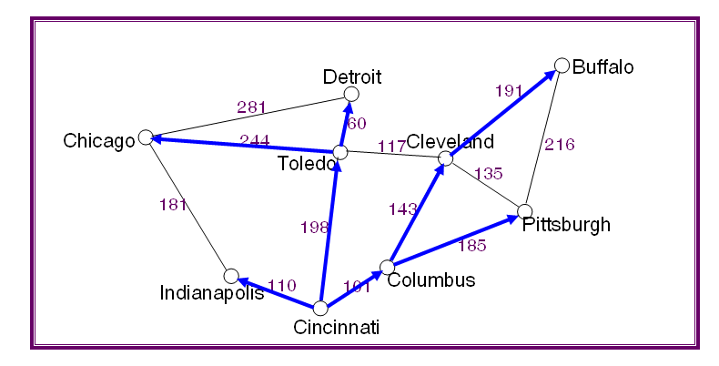
Breadth-First Traversal Method
(pseudo code)
Use a queue, as we did for level-order tree traversal:
  bfTrav(origin)
    origin.parent = null
    create a new queue q
    q.insert(origin)
    while (!q.isEmpty())
      v = q.remove()
      visit v
      for each vertex w in v's neighbors
        if w is not encountered
        mark w as encountered
        w.parent = v;
        q.insert(w);

Slide 12
Example: From Cincinnati
Tracing the queue operations
  insert(“Cincinnati”);
  remove(“Cincinnati”); // and print it
  insert(“Columbus”);
  insert(“Toledo”);
  insert(“Indianapolis”);
  remove(“Columbus”); // and print it
  insert(“Cleveland”);
  insert(“Pittsburgh”);
  remove(“Toledo”); // and print it
  insert(“Detroit’);
  insert(“Chicago”);
  remove(“Indianapolis”); // and print it
  remove(“Cleveland”); // and print it
  insert(“Buffalo”);
  remove(“Pittsburgh”); // and print it
  remove(“Detroit”); // and print it
  remove(“Chicago”); // and print it
  remove(“Buffalo”); // and print it
  bfTrav(origin)
    origin.parent = null
    create a new queue q
    q.insert(origin)
    while (!q.isEmpty())
      v = q.remove()
      visit v
      for each vertex w in v's neighbors
        if w is not encountered
        mark w as encountered
        w.parent = v;
        q.insert(w);

Slide 13
Breadth-First Spanning Trees
Cincinnati
Columbus
Toledo
Indianapolis
Cleveland
Pittsburgh
Detroit
Chicago
Buffalo

Slide 14
Example: From Cleveland
Detroit
Buffalo
191
281
60
Chicago
244
117
Cleveland
216
Toledo
135
181
143
198
Pittsburgh
185
Indianapolis
110
101
Columbus
Cincinnati

Slide 15
Running Time of Graph Traversal
Let V = number of vertices in the graph, and E = number of edges
Assume we use an adjacency list as the data structure
A traversal requires O(V + E) steps.
  visit each vertex once
  traverse each vertex's adjacency list at most once
    the total length of the adjacency lists is 2E = O(E)
  for a dense graph, E ➔V², so the worst-case bound is O(V²)
  for a sparse graph, O(V + E) << O(V²)

Slide 16
State-Space Search
EECS 233

Slide 17
Solving Problems by Searching A State Space
A wide range of problems can be formulated as searches of state space.
  more precisely, as the process of searching for a sequence of actions that take you from an initial state to a goal state
State space = all states reachable from the initial state by taking some sequence of actions.
State-space = graph
  States = nodes
  Actions = edges
Search = state graph traversal

Slide 18
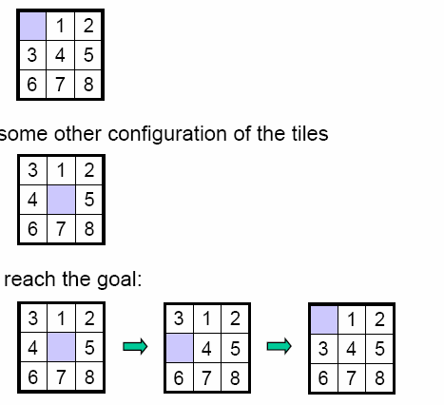
Example: A Puzzle
A 3 x 3 grid with 8 sliding tiles and one “blank”, and goal state:
Initial state: some other configuration of the tiles. Example:
A sequence of actions: slide tiles to reach the goal

Slide 19
Formulating A Search Problem
We need to specify:
  The initial state
  The operators: the actions that take you from one state to another
  The goal test: determines if a state is a goal state
    if only one goal state, see if the current state matches it
    the test may also be more complex (will see later)
    the costs associated with applying a given operator
      allow us to differentiate between solutions
      example: allow us to prefer 8-puzzle solutions that involve fewer steps
      can be 0 if all solutions are equally preferable

Slide 20

Formulating the Puzzle Search Problem
Initial state: some configuration of the tiles
Operators:
  at most four operators possible in a given state
    swap the black with the tile above, i.e., slide the upper tile down
    Slide the lower tile up
    Slide the left tile to right
    Slide the right tile to left
Goal test: simple equality test, because there’s only one goal
Costs:
  cost of each move = 1
  cost of a sequence of actions = the number of moves

Slide 21
Performing State-Space Search
Basic idea:
  If the initial state is a goal state, return it.
  If not, apply the operators to generate all states that are one step from the initial state (its successors).
  Then consider the successors, and their successors…

Slide 22
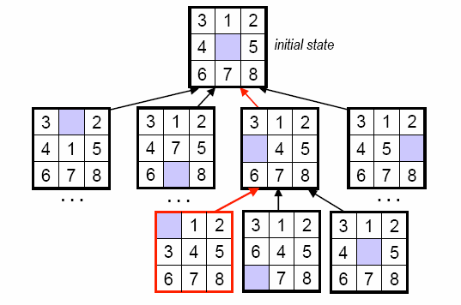
State-Space Search Tree
The predecessor references connect the search nodes, creating a traversal tree.
  Each node keeps information about its state, the reference to its parent (previous state), the action to reach it, the cost, …
When we reach a goal, we trace up the tree to get the solution, i.e., the sequence of actions from the initial state to the goal.

Slide 23
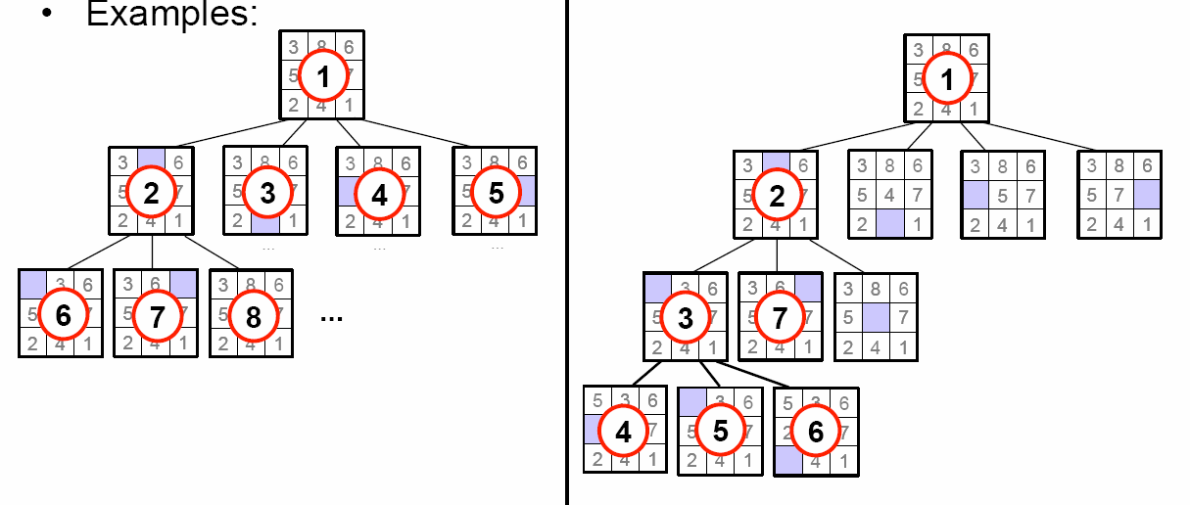
Search Strategies
Different search strategies correspond to different ways of considering the nodes in the search tree.
The two simplest strategies are breadth-first search and depth-first search

Slide 24
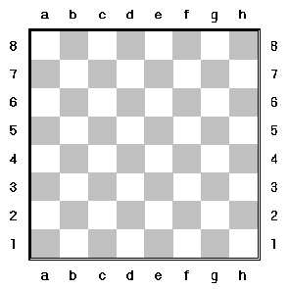

Example 2: 8 Queens on A Chess Board
Can we place 8 queens on the board so than none of them can attack any other?
No two queens can be on the same row, column, diagonal

Slide 25
Formulating the Eight-Queen Problem
initial state: empty chess board
operators:
  place a queen on board so that it does not share the raw, column or a diagonal with an existing queen
goal test: do we have 8 queens?
costs:
  We do not care about the cost. Any solution is equally good

Slide 26
State-Space Search Tree and Search Strategies
What does the tree look like?
  How many levels?
  How many children does each internal node have?
What search strategy is good to find a solution?
How to prune search tree?
Example:
  In May 1997, IBM's Deep Blue Supercomputer played a 6-game match with the Garry Kasparov, and won by 2W-1L-3T

